Slide 1

WEATHER FORECAST USING HISTORICAL DATA
BY
Lakshitha Parvathaneni
Tejasree Gajjala
Mohitha sai Kothapalli

Slide 2





INTRODUCTION
To predict the weather type for the weather dataset based on different parameters.
Random Forest Classification Algorithm has been used to predict the weather class from the data.
For the study, the project was formalized in machine learning using Jupyter notebook as well as Spark.

Slide 3





TOOLS
Jupiyter Notebook
Interactive Code and Data Exploration.
Allows to Create and share files easily
Spark
Highly integrated libraries for ML.
Provides interactivity with other languages. om
Anaconda Navigator
Easy way to work with packages and environments.
Discord
Group Communication
Sharing of documents, links

Slide 4

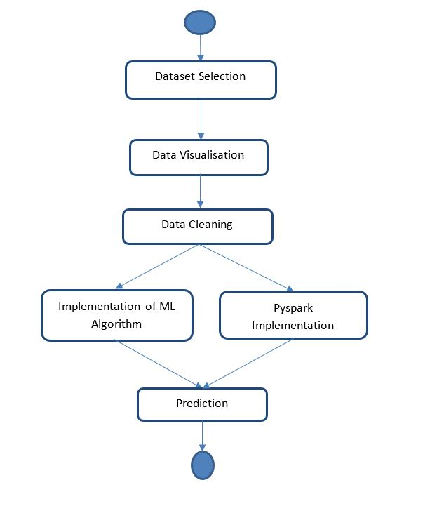
FLOWCHART

Slide 5

DATASET
Downloaded data from Kaggle, for several different weather characteristics, includes weather details from 2006 to 2016.
Weather data included data the for following weather features: Temperature, Apparent Temperature, Humidity, Wind Speed, Wind Bearing, Visibility, Loud Cover, Pressure, Daily Summary.
Link: https://www.kaggle.com/muthuj7/weather-dataset

Slide 6
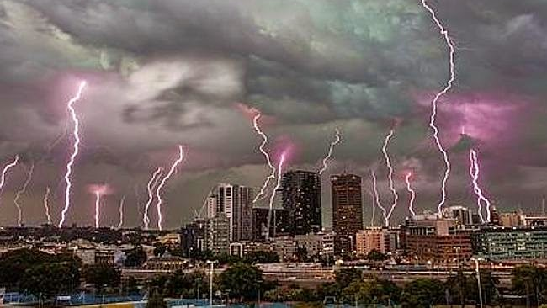
DATA VISUALISATION:
Libraries used:
Matplotlib
Seaborn
Pandas package

Slide 7
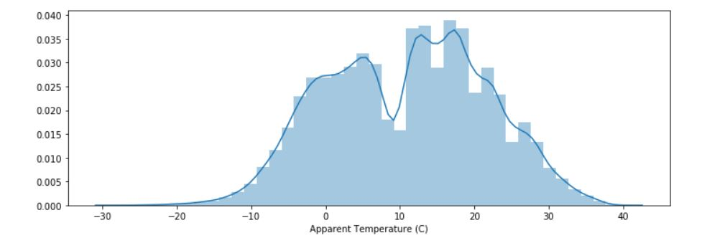
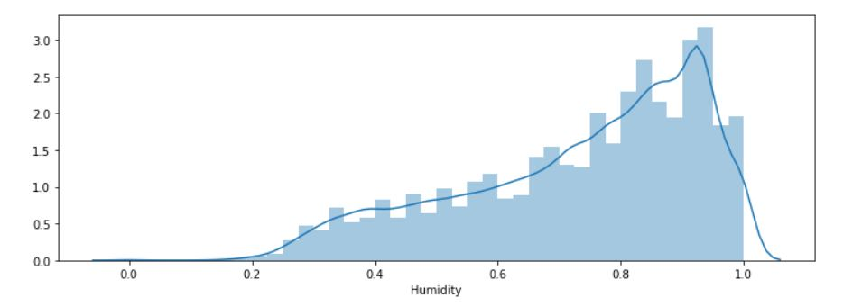
DATA VISUALISATION CONT’D..

Slide 8
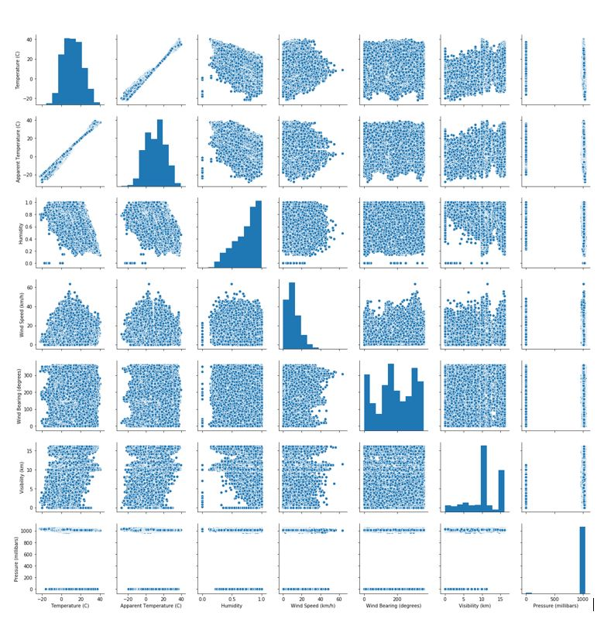

Slide 9
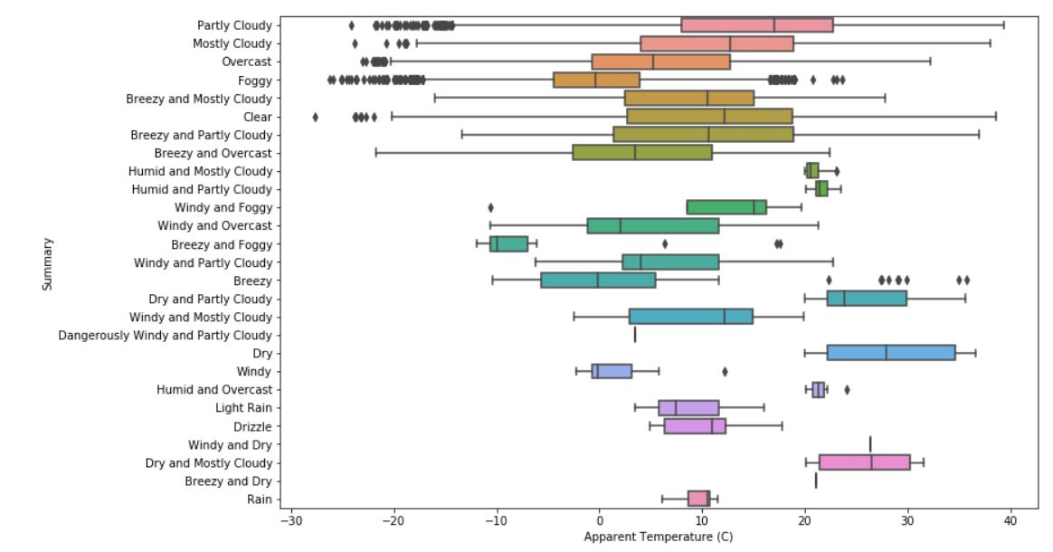
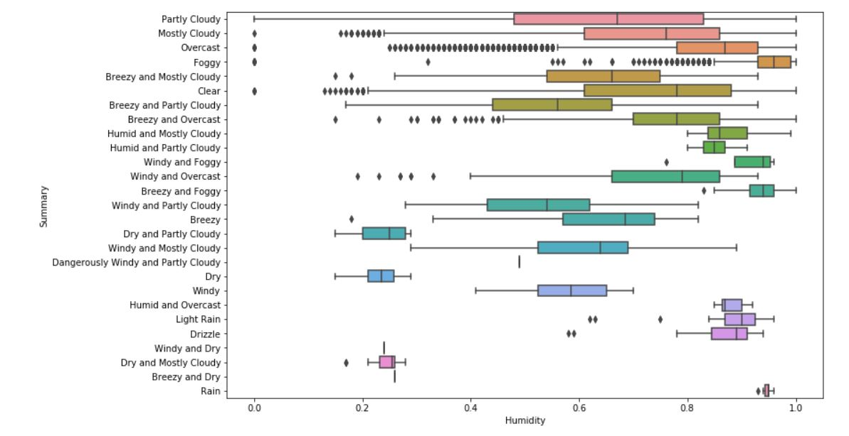
BOXPLOT

Slide 10

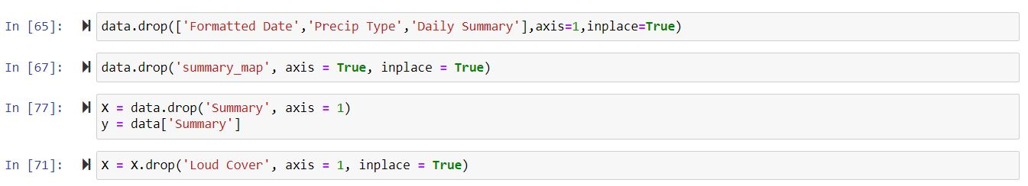
DATA CLEANING
Upon looking all the metrics and to use accurate input for the implementation, dropped some features in data

Slide 11
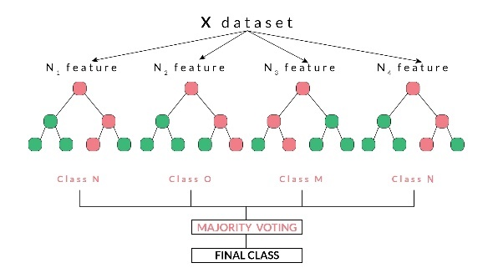
RANDOM FOREST CLASSIFICATION (RFC)
Random Forest is a supervised learning algorithmic approach which can be used for both classification and regression problems.
It uses a forest or collection of decision trees in order to obtain the classification result.
Random forest is mainly based on two stages, the first stage being the creation of the random forest and the second stage is the prediction from the random forest being created in the first stage.

Slide 12
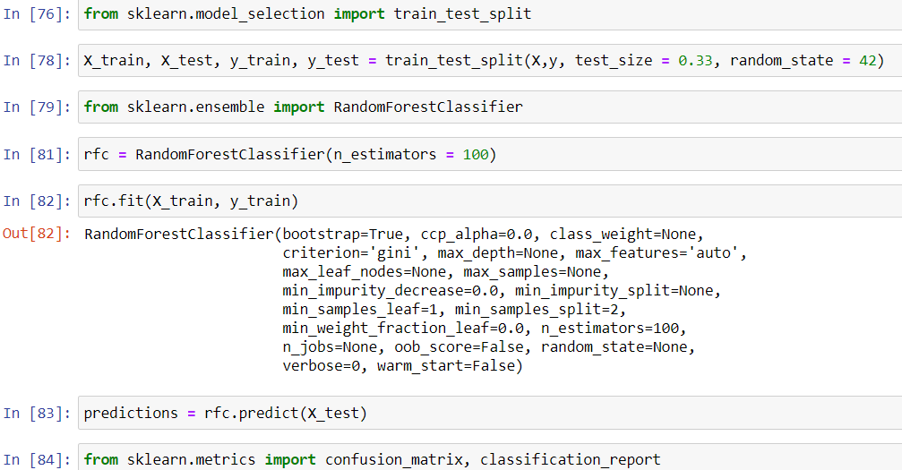
RANDOM FOREST CLASSIFICATION CONT’D..
Snippet of code in python:

Slide 13
RFC IMPLEMENTATION IN PYSPARK
Pipeline: A sequence of stages
Components of Pipeline: Dataframe , transformers, Estimator.
Transformers: It is an abstraction comprising transformers of features and learned models
Estimator: An Estimator uses a fit() process, which accepts a DataFrame and produces a Transformer model.

Slide 14
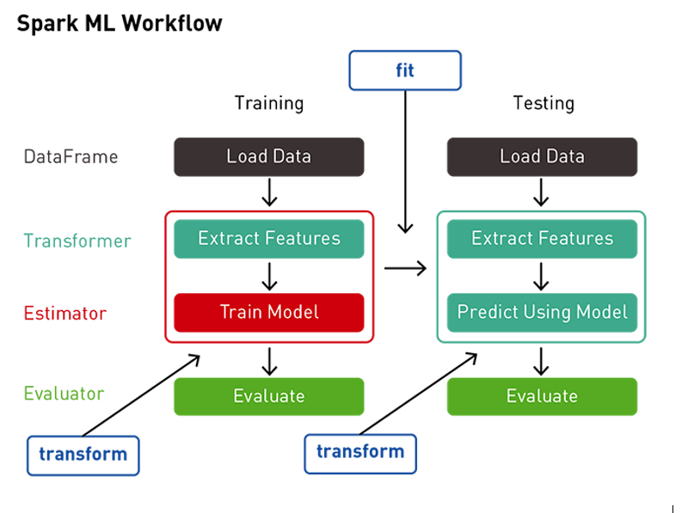
RFC IMPLEMENTATION IN PYSPARK CONT’D..

Slide 15
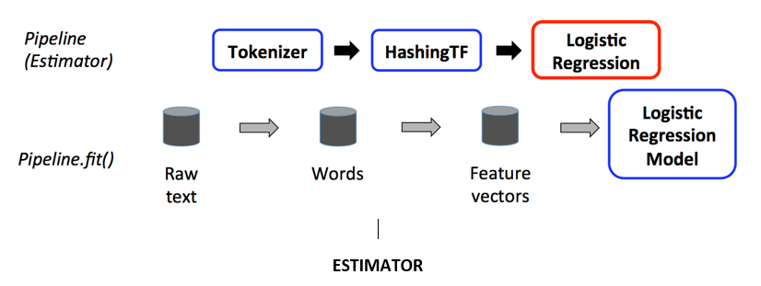
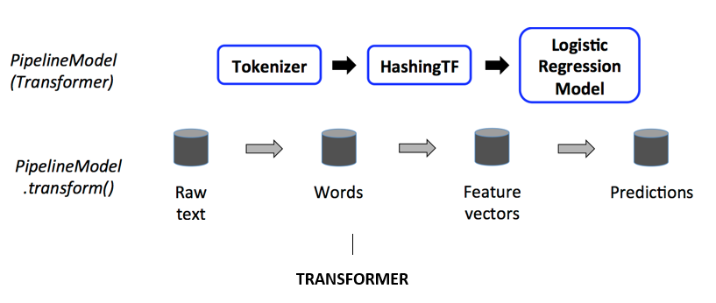
RFC IMPLEMENTATION IN PYSPARK CONT’D..

Slide 16
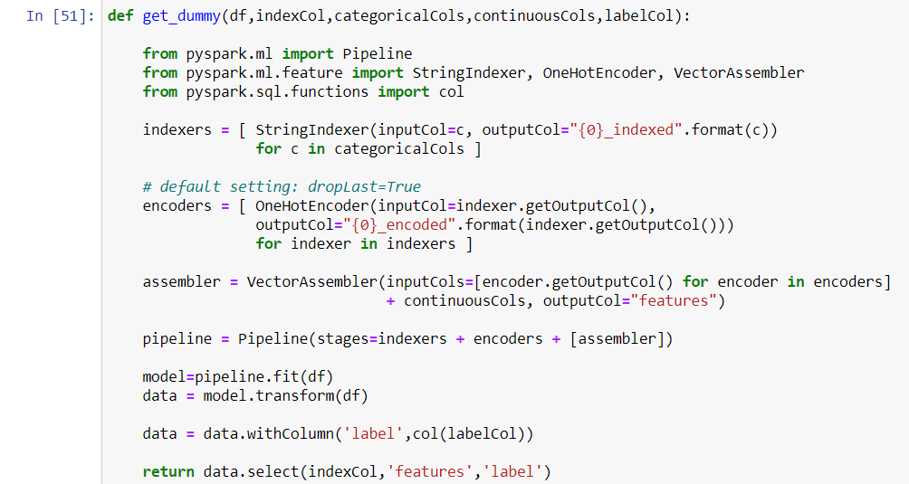
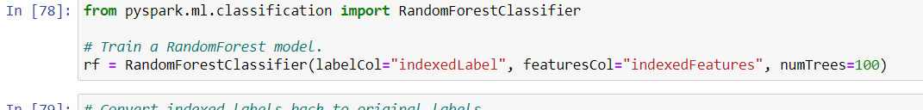
RFC IMPLEMENTATION IN PYSPARK
SNIPPET OF CODE FOR PIPELINE:
SNIPPET OF CODE FOR RFC:

Slide 17

CONCLUSION
Successful implementation of “WHAT HAS HAPPENED” predictive analysis.
Given certain parameters with values, prediction of what might be the weather class.

Slide 18

FUTURE WORK
Optimization can be achieved by implementing other Machine Learning algorithms like neural networks, naïve bayes etc. and comparing the output for accuracy.
Oversampling and Undersampling can be done to balance the data class.

Slide 19
REFERENCES
https://spark.apache.org/docs/latest/ml-classification-regression.html#logistic-regression
https://spark.apache.org/docs/latest/ml-pipeline.html
https://www.datacamp.com/community/tutorials/apache-spark-tutorial-machine-learning#basics
https://www.nbshare.io/notebook/187478734/How-To-Read-CSV-File-Using-Python-PySpark/
https://databricks.com/session/deploying-machine-learning-models-with-apache-spark

Slide 20

WORK DIVISION
DATA SELECTION: ALL
DATA VISUALISATION AND CLEANING --
IMPLEMENTATION OF ML ALGORITHM --
PYSPARK IMPLEMENTATION
DOCUMENTATION --ALL

Slide 21
THANK YOU !!!!

